Slide 1
IoT-BASED SMART GARAGE SYSTEM
Gayatri Sreeraj
21BAI1171
TEAM MEMBERS:
GAYATRI SREERAJ (21BAI1171), GAYATRI MOITRA (21BRS1293), SANNIDHYA MATE (21BAI1176)

Slide 2
CONTENTS
Introduction​
Problem Statement Description ​Components, circuit, working and code
Implementation
Results Limitations Conclusion
References

Slide 3
Introduction
The Smart Garage System presented in this project is an innovative and intelligent solution aimed at revolutionizing the traditional garage experience. Leveraging the power of the Internet of Things (IoT) and Arduino microcontroller technology, the system comprises two essential components: the Smart Parking System and the Smart Lighting System.

Slide 4
The Smart Parking System is designed to streamline the parking process by providing real-time information about parking space availability within the garage. Ultrasonic distance sensors, strategically positioned above each parking spot, detect the presence of vehicles. The Arduino microcontroller processes the sensor data and triggers LED indicators near the garage entrance, indicating the occupancy status of each parking space. This feature enables users to efficiently locate available parking spots, minimizing search time and easing congestion.
In conjunction with the parking management component, the Smart Lighting System ensures energy-efficient and smart lighting within the garage. An infrared (IR) motion sensor captures movement within the premises, promptly communicating with the Arduino microcontroller. When motion is detected, the Arduino activates the LED lights, illuminating the garage. After a period of inactivity, the system automatically turns off the lights, promoting energy conservation and reducing operational costs.

Slide 5
PROBLEM STATEMENT
1. Remote Garage Door Control: The primary objective of this project is to enable users to remotely open and close their garage door using a smartphone or a web interface.
2. Parking Space Availability: The project aims to implement a smart parking system that detects and displays the availability of parking spaces within the garage.
3. Lack of Real-Time Parking Information: Traditional parking systems do not provide real-time information on parking space availability.
4. Manual Management and Monitoring: The manual management and monitoring of parking areas are prone to errors and delays. Traditional systems rely on human intervention for tasks such as ticketing, payment, and spot monitoring, which can result in inefficiencies and inconsistencies.
5. Automated Lighting Management: Integrating motion and ambient light sensors with the Arduino, the system will automatically control the garage lighting.
6. Energy Usage Monitoring: The project will include energy monitoring functionality, allowing users to track and analyze energy consumption patterns for the garage lighting.

Slide 6
DESCRIPTION
The Smart Garage System is an innovative IoT project that comprises two integral components: the Smart Parking System and the Smart Lighting System.
Both components are powered by Arduino microcontrollers and designed to enhance parking convenience and energy-efficient lighting within the garage.

Slide 7
Smart Parking System
The Smart Parking System utilizes an Arduino microcontroller, an ultrasonic distance sensor, LEDs, jumper cables, wire, and a mini breadboard to create an intelligent parking management solution. The system aids users in finding available parking spaces and streamlines the parking process. An ultrasonic distance sensor is placed above each parking spot, facing downward to detect the presence of vehicles. The ultrasonic sensor measures the distance between itself and any object below it, such as a car. When a car is parked in a spot, the Arduino microcontroller processes the data from the ultrasonic sensor and detects the presence of the vehicle. If a car is detected within the parking spot, the Arduino triggers an LED on the mini breadboard to blink or light up, indicating that the spot is occupied. As cars leave and parking spots become available, the LED corresponding to the vacant spot stops blinking, indicating its availability to other drivers.

Slide 8
Smart Lighting System
The Smart Lighting System incorporates an Arduino microcontroller, an infrared (IR) motion sensor, LEDs, jumper cables, wire, and a mini breadboard. This component focuses on energy-efficient lighting management within the garage. An infrared (IR) motion sensor is positioned strategically within the garage to detect any movement. When the IR sensor detects motion, it sends a signal to the Arduino microcontroller. Upon receiving the motion signal, the Arduino triggers the LED lights on the mini breadboard to turn on, illuminating the garage.

Slide 9
COMPONENTS

Slide 10
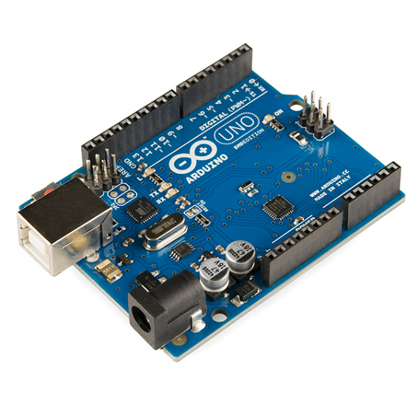
I. ARDUINO MICROCONTROLLER

Slide 11
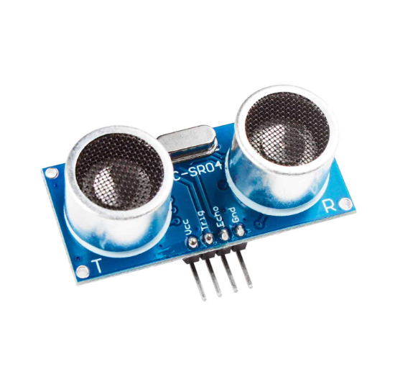
II. ULTRASONIC DISTANCE SENSOR

Slide 12
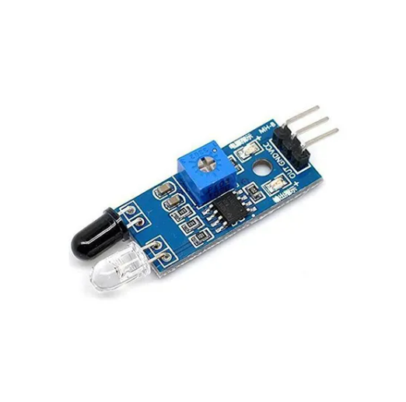
III. IR SENSOR

Slide 13
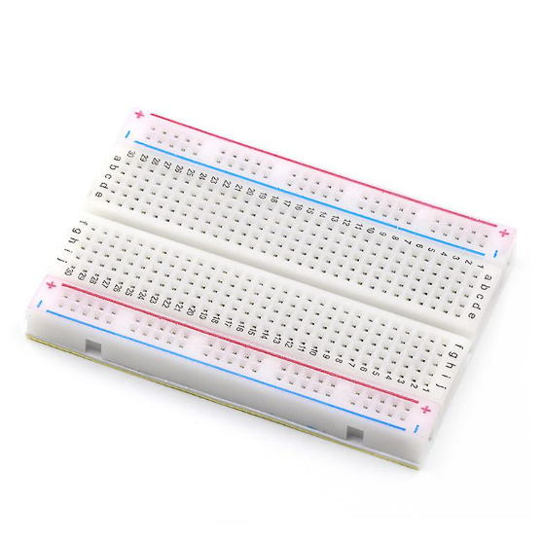
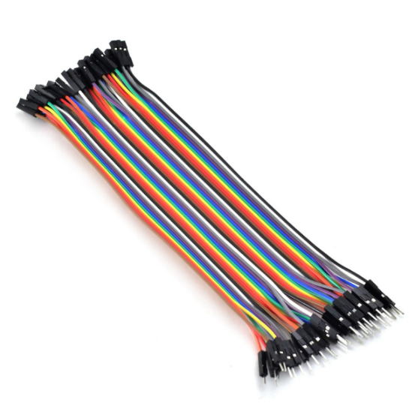
IV. MINI BREADBOARD AND WIRES

Slide 14
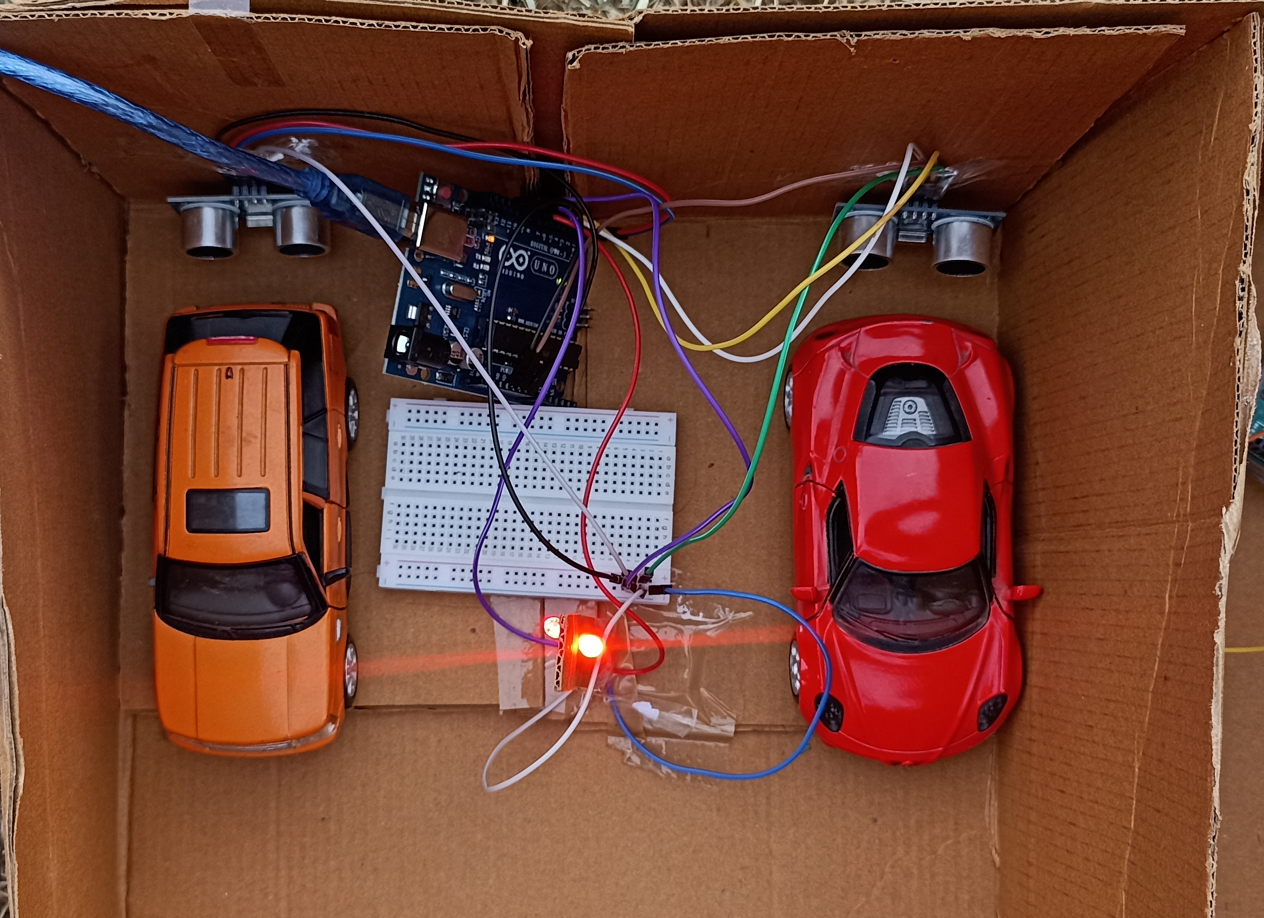
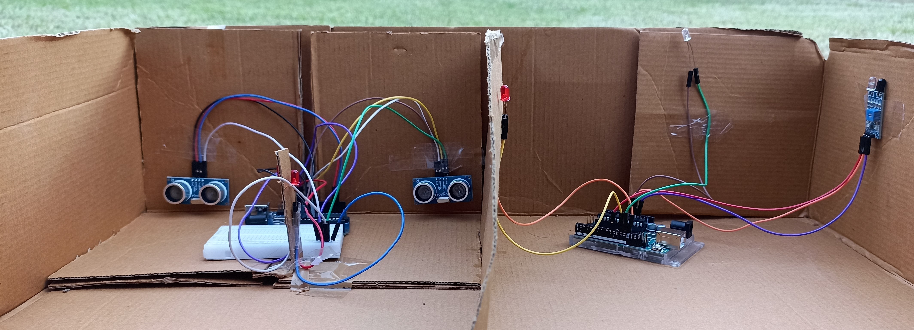
CIRCUIT
SMART LIGHTING SYSTEM
SMART PARKING SYSTEM​

Slide 16
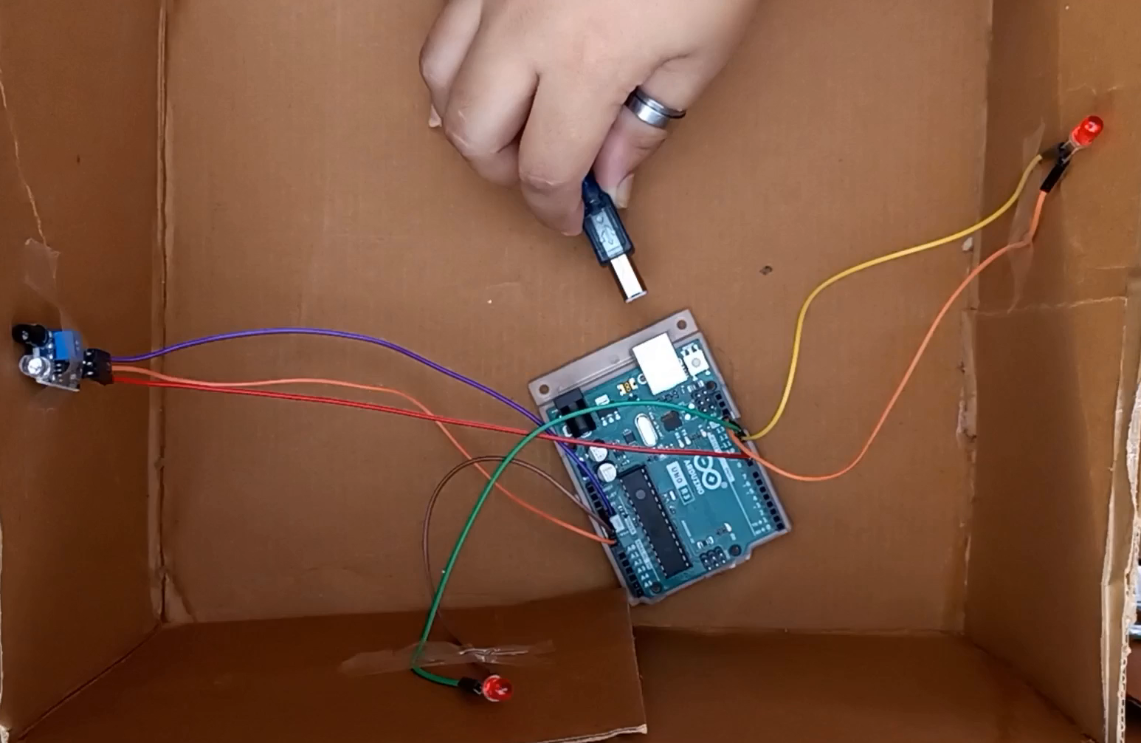
WORKING OF SMART LIGHTING SYSTEM

Slide 17
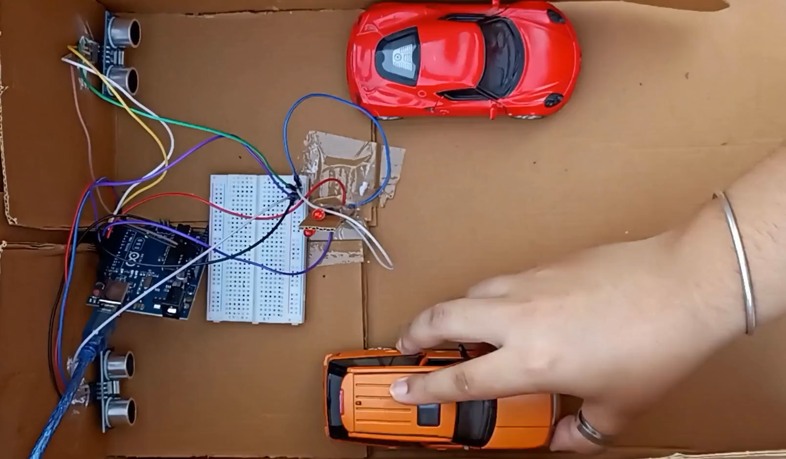
WORKING OF SMART PARKING SYSTEM

Slide 18
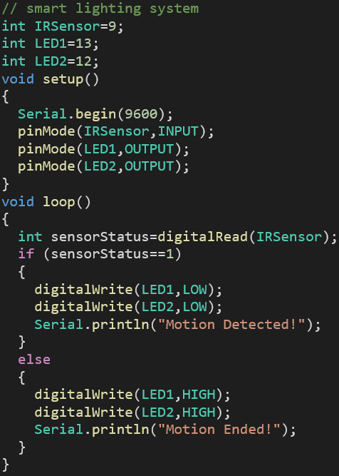
CODE FOR SMART LIGHTING SYSTEM

Slide 19
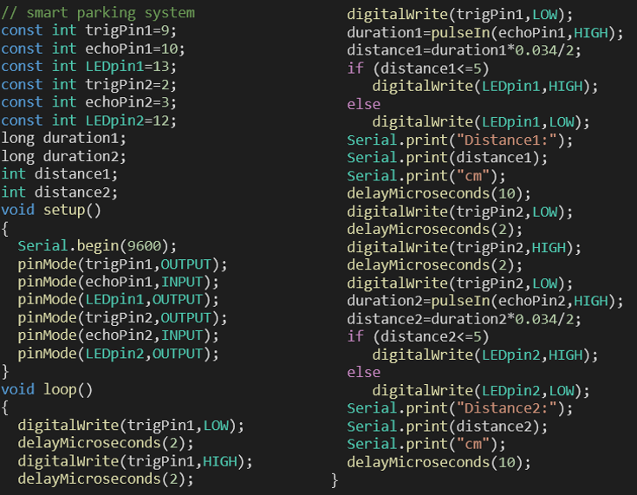
CODE FOR SMART PARKING SYSTEM

Slide 20
IMPLEMENTATION
RESEARCH
DESIGN
DEVELOPMENT
TESTING
DEPLOYMENT
Conduct a thorough review
Design the system architecture
Program the Arduino microcontroller
Testing to ensure the functionality
Install the Arduino devices and sensors in the garage

Slide 21
RESULTS
Real-time Parking Space Monitoring: The Smart Parking System continuously monitors the occupancy status of each parking spot using ultrasonic distance sensors.
Enhanced Parking Convenience: With the LED indicators clearly indicating the status of each parking spot, users experience improved convenience and efficiency in finding available parking spaces quickly and hassle-free.
Optimal Space Utilization: The Smart Parking System optimizes the utilization of parking spaces, ensuring that the garage's capacity is maximized at all times.
Motion-Activated Lighting: The Smart Lighting System utilizes infrared (IR) motion sensors to detect movement within the garage. When motion is detected, the Arduino microcontroller activates the LED lights, providing sufficient illumination for users' safety and convenience.
Energy-Efficient Lighting: By automatically turning off the LED lights after a specified period of inactivity, the Smart Lighting System promotes energy efficiency, reducing electricity consumption and operational costs.

Slide 22
LIMITATIONS
1. Reliance on Stable Internet Connectivity: The IoT-based Smart Garage System heavily depends on a stable internet connection for real-time monitoring and data transmission.
2. Potential Sensor Inaccuracies: While IR sensors are generally reliable, environmental factors such as extreme weather conditions or physical obstructions may affect their accuracy in detecting vehicle presence.
3. Scalability Challenges: The system may face challenges when scaling up to accommodate a larger number of parking spaces.
4. Maintenance Requirements: The hardware components, including IR sensors, may require periodic maintenance to ensure their proper functioning.

Slide 23
CONCLUSION
In conclusion, The IoT-based Smart Garage System using Arduino is a promising solution to address the challenges of parking management and traffic congestion in metropolitan areas. By leveraging the capabilities of IoT devices, sensor technology, and cloud-based platforms, the system offers several benefits including improved parking efficiency, enhanced user convenience, and data-driven insights.
Through the implementation of this system, real-time data on parking availability and parking time can be collected, allowing users to quickly locate vacant parking spaces and reduce the time spent searching for parking. The smart parking system and smart light system with ultrasonic distance sensors and IR sensors ensures smooth entry and exit processes, optimizing the overall efficiency of the garage system.

Slide 24
REFERENCES
https://en.wikipedia.org/wiki/Arduino_Uno
https://www.hindawi.com/journals/js/2022/9070683/
https://www.thegeekpub.com/wiki/sensor-wiki-ky-050-hc-sr04-ultrasonic-sensor/
https://roboticsdna.in/product/ir-sensor-digital-single-array-line-sensor/

Slide 25
THANK YOU
Gayatri Sreeraj
21BAI1171
gayatri.sreeraj2021@vitstudent.ac.in

